Slide 1

Network Defragmentation in Virtualized Data Centers
Invited Talk, University of Lisbon, Sep. 26th 2017
Oliver Michel
Eric Keller
Fernando Ramos (ULisbon)

Slide 2
Virtualized Data Centers
Virtual Servers / Virtual Networks
Virtual Servers / Virtual Networks
Services / Applications
Services / Applications
Hypervisor
Hardware
Servers, Networking Equipment, Cabling, etc.
Notes:
Today’s cloud setups (both private and public) use network and machine virtualization
abstraction that decouples deployment of services and apps from underlying hardware \
realized through hypervisor layer \
services and apps that run on virtual networks can be deployed \
multiple at at same time with some level of isolation

Slide 3
Virtualized Data Centers
Coexistence of tenants on shared infrastructure
Reduces infrastructure cost for tenants
by only using exactly required resources
allow scaling of resources based on demand
Cornerstone of cloud computing (IaaS)
Notes:
widely used technique to allow the coexistence of multiple tenant networks on a shared physical infrastructure \
reduces infrastructure cost and allows for flexibility for tenants
only use exactly the resources currently required
add or remove resources based on demand \
cloud computing - specifically Infrastructure as a Service (IaaS)

Slide 4
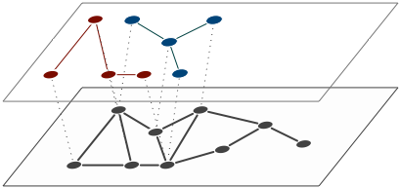
Virtual Topologies
Different cloud applications require different topologies
Links must provide certain QoS guarantees
Notes:
4 main characteristics, components such a solution must support
first, virtual topologies
cloud applications have varying demands for topologies
web and enterprise often tiered approach with network functions between stages for isolation
analytics often high connectivity between all nodes with guaranteed bw/latency
or some hybrid form \
Links in such custom topologies often must provide QoS guarantees for latency or bandwidth, performance isolation w/ fixed reservations

Slide 5
Dynamic Virtual Topologies
Ability to quickly provision resources as they become needed
Adaption of network topology
Notes:
second, dynamic virtual topologies
ability to quickly and easily request resources as they are needed (multiple times per day) \
network topology needs to adapt to changing application needs (e.g. add middlebox during ddos)

Slide 6
Network Control
More than best-effort packet delivery between VM’s
Custom forwarding logic
Middle box functionality
Traffic engineering
Notes:
third, network control
more than best effort packet delivery
specify custom forwarding logic, middle box functionality and traffic engineering
idea is that better control and QoS guarantees lead to better application performance
with SDN technologies this is achievable

Slide 7
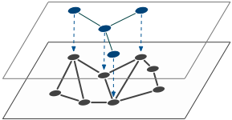
Virtual Network Embedding
Coordinated node and link mapping
NP-Complete
Extensive Body of Research
Mostly heuristics, generally poor scaling behavior
Notes:
fourth, embedding (more component)
coordinated node and link mapping is required for such advanced network performance guarantees
reserved, fixed bandwidth and other QoS constraints \
problem is computationally intractable (belongs to NP-Complete Problems) \
extensive body or research, heuristical and metaheuristical solutions, generally poor scaling behavior

Slide 8
Challenges in Data Centers
Most solutions only support some subset of requirements
Most solutions unsuitable for Data Center environments
Notes:
looking at solutions and evaluating them based on the four requirements
great in principle but implementation varies significantly
most solutions (academic as well as industrial) only support some subset \
not VNE talk and we are not aiming at solving this problem
identified more systemic issues with most research that makes most unsuitable for DC environments

Slide 9
Challenges in Data Centers
No differentiation between types of nodes
Limited support for virtual topologies
No Performance Isolation
Notes:
no differentiation between network or compute nodes, i.e. VMs, programmable switches etc. \
limited support for virtual topologies (most prevalent single L2 domain) \
no performance isolation

Slide 10
Challenges in Data Centers
Multiple VMs from same request on single hypervisor
Geared towards and evaluated on mesh-like networks
Focus on embedding entire network at a time (no scaling)
Notes:
Don’t allow for multiple VMs out of the same request to be mapped on single hypervisor…MCF formulation \
Most work evaluated on mesh-like networks, high average node degree, historically from WAN
some point solutions for trees but they then generally don't support arbitrary topologies \
Work does not match the use of cloud infrastructure where resources need to dynamically scale

Slide 11
This paper
Expand VN / Contract VN
+
Optimize Embeddings
(Defragmentation)
Notes:
not trying to provide a solution to all of these problems or propose ultimate VNE algorithm
instead, we analyzed what building blocks/primitives are required to work towards this goal using existing solutions
identified two main areas \
need management abstractions for expand and contract: integrate into existing algorithms (we did this) \
without knowledge of upcoming requests very hard to find globally optimal embeddings
reverse approach…periodically optimize the network

Slide 12
New Network Management Primitives
Virtual Network Lifecycle
Embed VN
Expand
VN
Contract
VN
Remove VN
Notes:
introduce two new primitives within lifecycle of virtual network \ \
expand network, i.e. add nodes and links to networks given some constraints \
contract network, i.e. remove subset of nodes and their links from the network

Slide 13
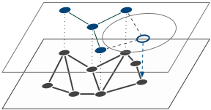
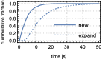
Expand/Contract Networks
Expansion based on existing VNE scheme [Rabbani13]
Contraction by careful removal of nodes
Notes:
used existing scheme and expanded LP formulation to expand networks
essentially new embedding with extra constraints
old nodes/links must stay in original place
new nodes must be connected to old network in particular way
contraction: must make sure the graph is still connected and some other constraints are not violated

Slide 14
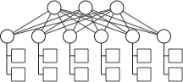
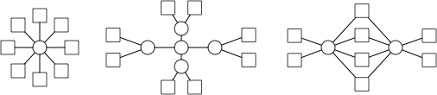
Simulation
Cloud simulator
Leaf-Spine physical topology
Different virtual topologies [Ballani11]
New/Expand/Contract/Remove
Leaf-Spine Physical Network Topology
Virtual Network Topologies: VC, VOC, 3T
Notes:
implemented cloud simulator
generally support for arbitrary topologies, adjacency lists
demand vectors (CPU, memory etc.)
compute mapping then atomically roll out
new/expand/contract and remove networks
save configuration, replay of mappings, etc.

Slide 15
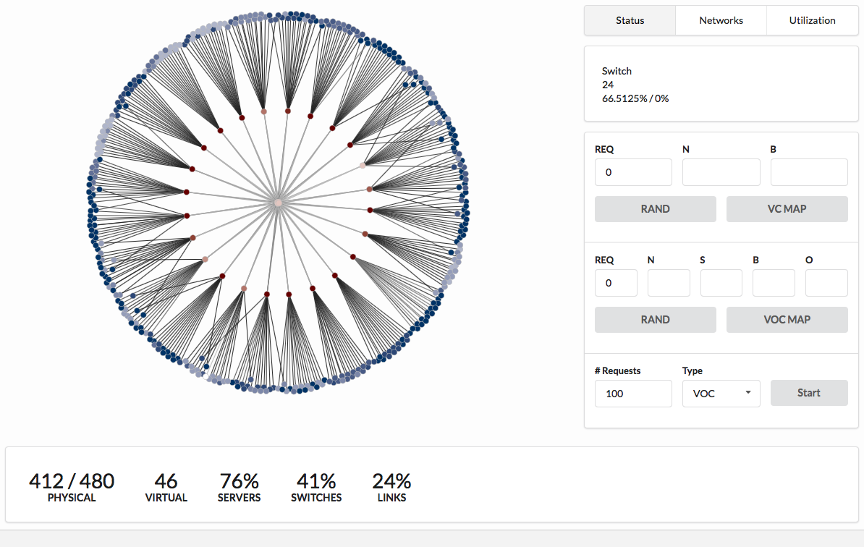
Simulation
Notes:
UI with visualization, helped a lot
Physical leaf spine, color indicates utilization
see #nodes/#links #vn, utilization etc

Slide 16
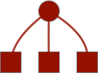
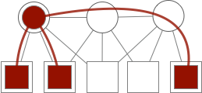
Simulation
Resource Utilization Distributions
Embedding Time
Path Length Stretch
link 3 stretch = 3
mean stretch = 5/3 ≅ 1.66
Notes:
collected various metrics
resource utilization distributions: vector of utilization of each physical resource \
runtime, network size exponentially \
stretch for each virtual link \ \ \ …

Slide 17
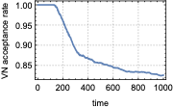
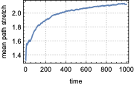
Resource Fragmentation
Notes:
Main problem (not news) is resource fragmentation
Compare disk fragmentation, resources not laid out contiguously,
previously described in literature
but: expansion makes problem significantly worse \
first graph: acceptance rate over time \
second graph: mean path stretch over time

Slide 18
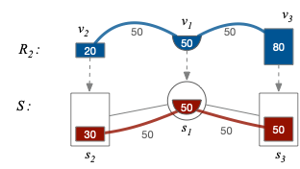
Resource Fragmentation
Notes:
two different problems: even path utilization distribution leads to decreasing acceptance rate
toy example, Substrate nodes and links 100

Slide 19
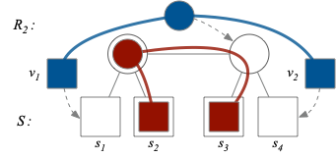
Resource Fragmentation
Notes:
second problem: path stretch leads to poor application performance
toy example
No 1:1 correspondence between virtual and physical link

Slide 20
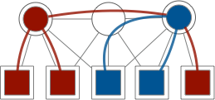
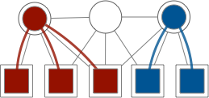
Network Defragmentation
no prior knowledge of upcoming request
hard to optimize VNE algorithms to avoid fragmentation
explicit defragmentation, i.e. periodically run a network migration algorithm
Notes:
How to solve this
vastly varying assumptions made in VNE papers, but usually hard to predict upcoming workloads
since fragmentation stems from online character of the problem \
hard to optimize algorithms for it \
explore if we can do something like this: optimize the network \ \..
that is run some VN migration algorithm that optimizes the network periodically

Slide 21
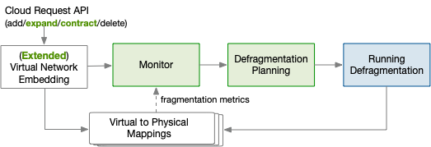
Network Defragmentation
Notes:
sort of control loop, monitor the network, plan fragmentation, future work

Slide 22
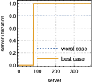
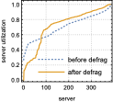
Network Defragmentation
Naive realization: remap all networks
Upper bound on effectiveness of approach
Notes:
looked at naive realization: remap all networks to predict upper bound on effectiveness
first look at first subproblem: utilization distribution, best if resources are either fully utilized or entirely available (also could conserve energy by shutting down etc). \
first graph: theoretical, ideal case \
second graph: simulation before and after defrag…looks ‘more’ like left, step character

Slide 23
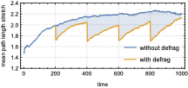
Network Defragmentation
Notes:
second: path stretch
time step is an add/expand/contract/delete operation
exactly same workload, deterministic embedding, with and without defrag

Slide 24
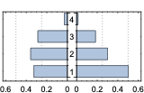
Network Defragmentation
Fraction of paths by length
before
defrag
after
defrag
Notes:
mean is good, but this is the full distribution
paths were either of length 1,2,3,4, 4 being the physical network diameter (worst case)
see redistribution of path lengths, cut worst by 52%, length 3 by 62%

Slide 25
Future Work
Advanced Fragmentation Analysis/Selective Migration
Minimizing Migration Cost
Notes:
advanced analysis: rejections can be due to small local effects, where a single network blocks access to the rest of a subtree, doesn't require remapping everything \
migration cost: cost associated with migration: need some tradeoff between optimality of placement and migration cost, e.g. only remap worst networks …requires simulation

Slide 26
Conclusion
New Requirements for VNE in the cloud
Challenges associated with Scaling VNs
Quantify Resource Fragmentation Problem
Network Defragmentation as a new Management Primitive
Powerful technique to improve network resource usage and performance
Notes:
in conclusion: 4 contributions
defined requirements for VNE in data center settings and propose expand/contract \
identified challenges with scaling: fragmentation \
identified metrics for fragmentation problem \
instead of further optimizing placement, propose defragmentation as a solution \
finally, showed through simulations that this can be a very powerful technique improving network utilization and performance

Slide 27
Q&A / Discussion
Oliver Michel
oliver.michel@colorado.edu
http://nsr.colorado.edu/oliver

